Slide 1
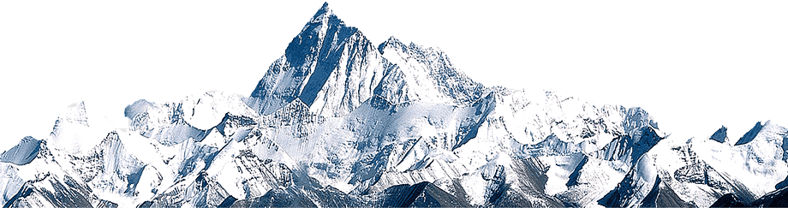
Analysis of Snow Cover in Manali using NDSI and Time series

Slide 2
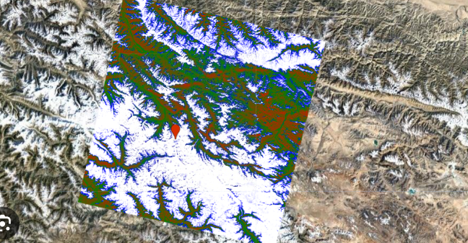
Introduction - What is NDSI ?
Normalized Difference Snow Index
NDSI = (NIR - SWIR) / (NIR + SWIR)
Snow covered pixels have NDSI value closer to 1
Snow covered percentage is calculated by dividing the snow covered pixels by total no. of pixels

Slide 3

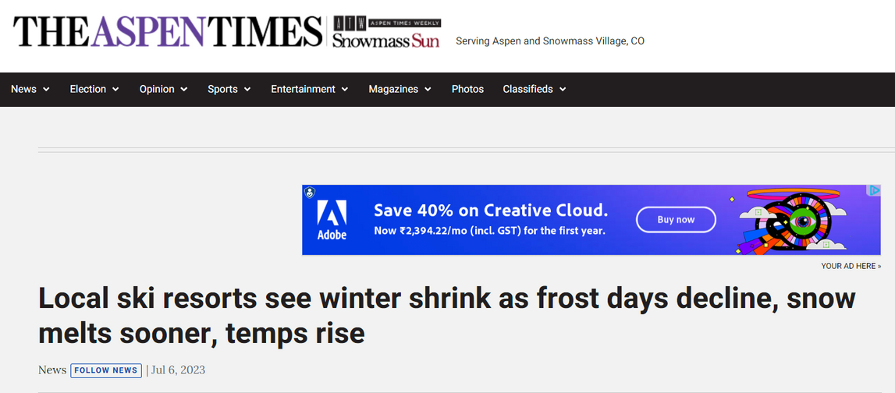
Introduction - Monetary Gains ?
Global Skiing industry is expected to reach 2.32 billion USD by 2032
The number of active ski resorts is also increasing
Climate change is resulting in faster melting

Slide 4
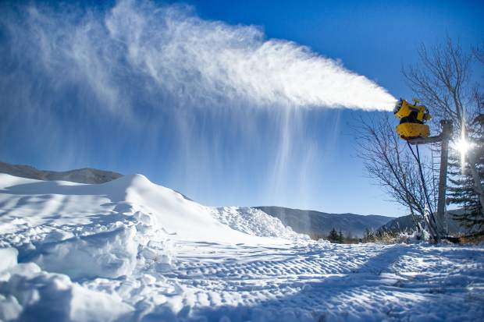
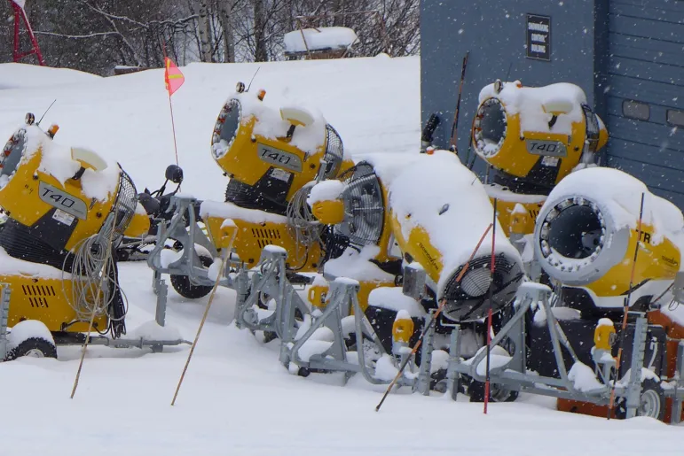
Introduction - Monetary Gains ?
Ski resorts can forecast the expected snow cover for a certain region based on historical data

Slide 5

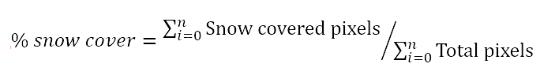
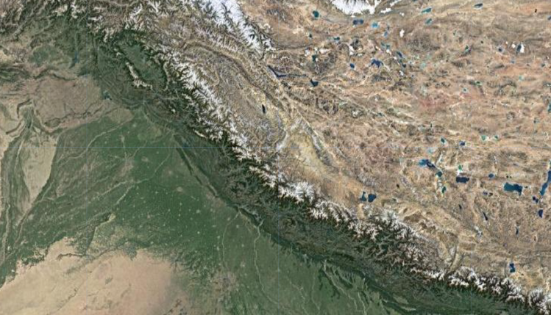
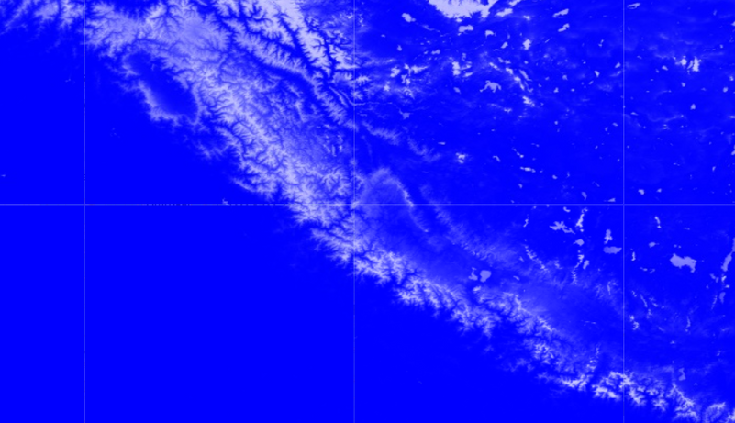
Procedure :- Data Collection and Preprocessing
Data from 2010 to 2020 was extracted from Manali region using Google Earth Engine’s MODIS dataset taken from NASA satellites of Terra and Aqua.
After NDSI conversion the % of snow cover was calculated ie.
After NDSI conversion

Slide 6
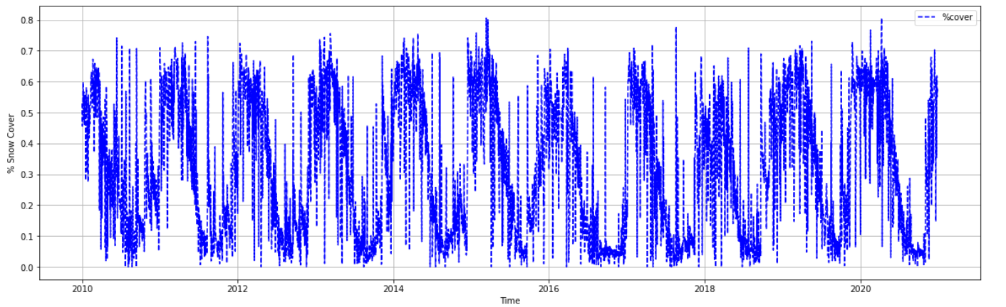
dataset with noise

Slide 7
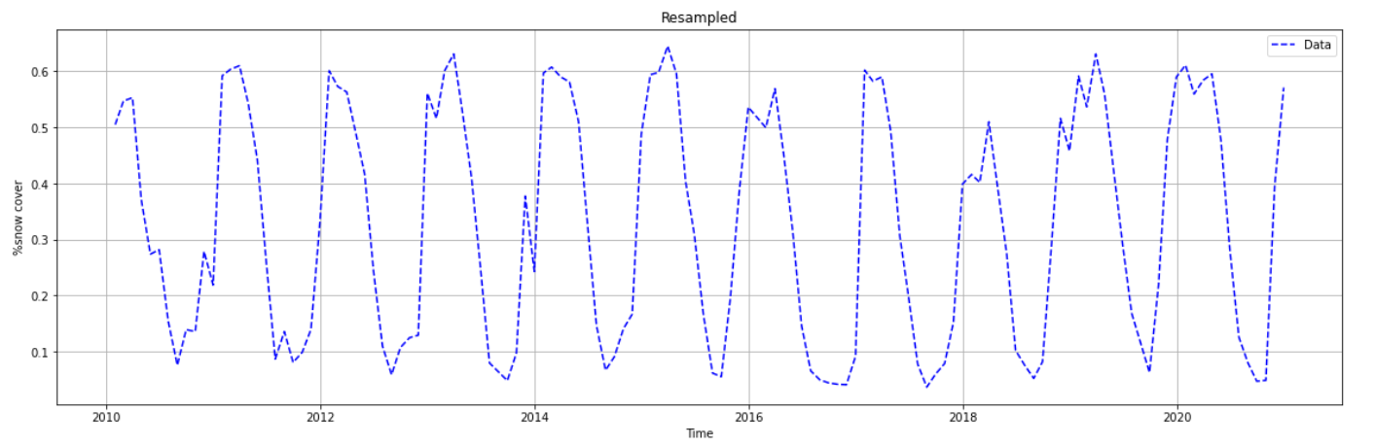
resampled dataset

Slide 8
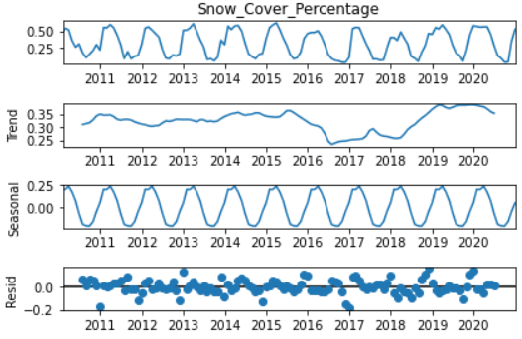
Seasonal Decompose

Slide 9
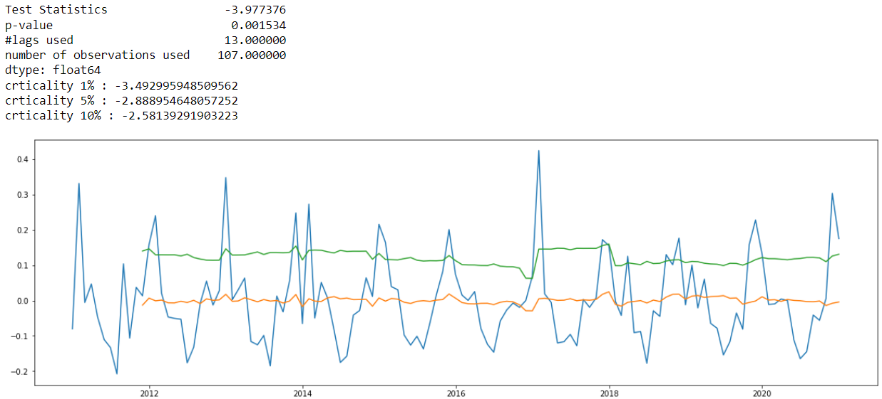
Stationarity achieved with shift-differencing once

Slide 10
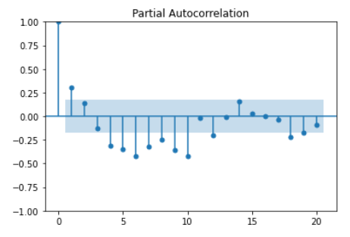
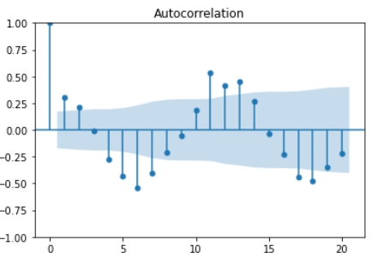
PACF and ACF plots
(p,d,q) = (1,1,1)
(p,d,q,s) = (1,1,1,12)

Slide 11
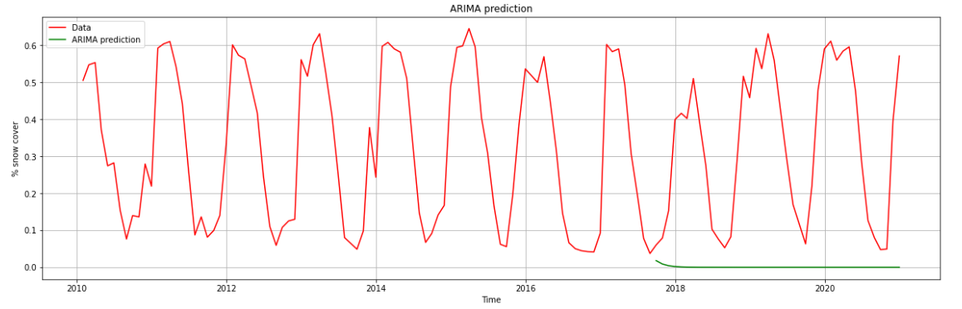
ARIMA results
MSE: 0.1520574941056795

Slide 12
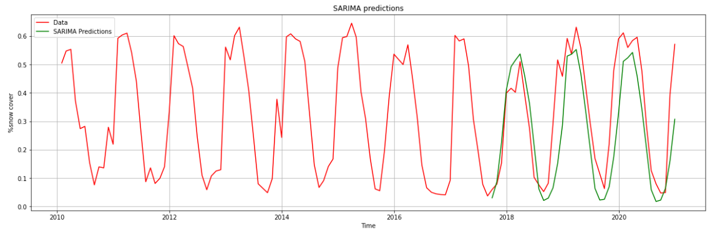
SARIMA results
MSE: 0.017432157234285844

Slide 13
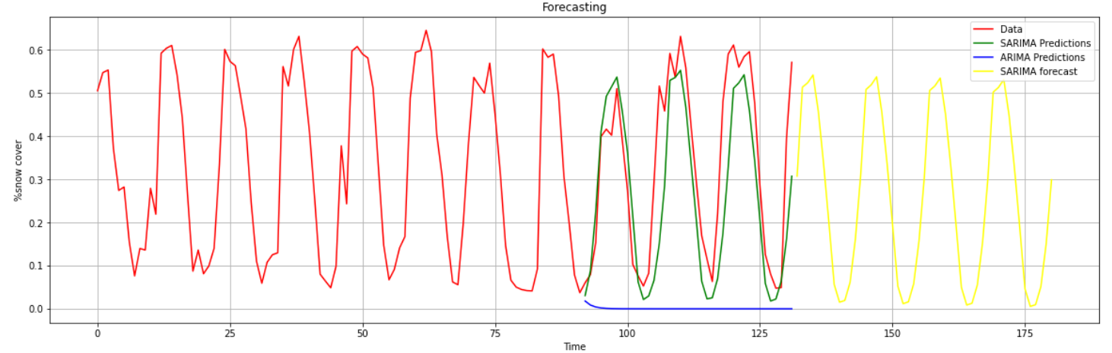
SARIMA Forecasts

Slide 14
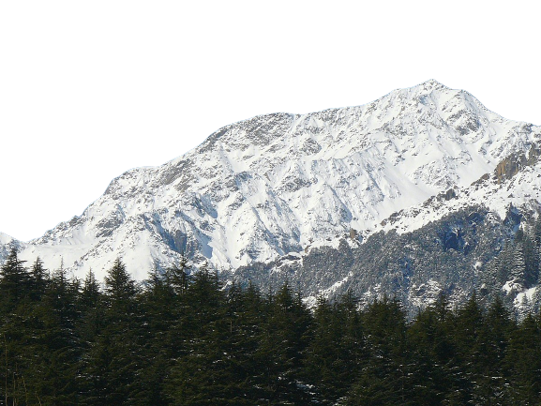
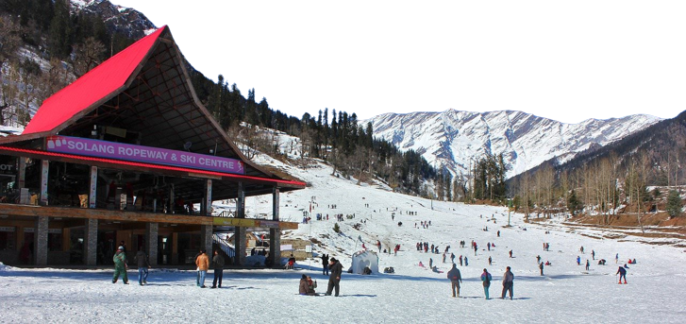
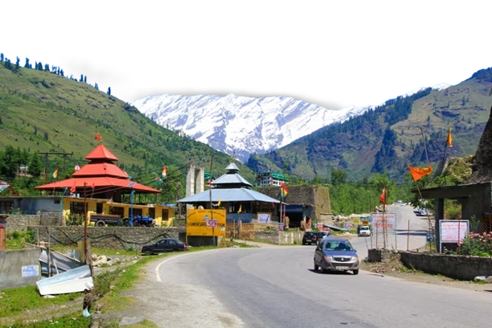
THANK YOU

